Slide 1
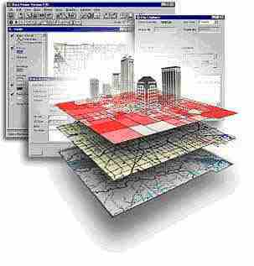
Geospatial Research Methods
GSP 510
Instructor: Jim Graham
E-mail: James.Graham@Humboldt.edu

Slide 2
About the class
This is an introduction to how to properly use geospatial data and methods in research
The class substitutes for GSP 101 and GSP 270
The class is for graduate students and thus the amount of work will be much higher than either of the other classes!
This class will prepare you for GSP 216, GSP 316, GSP 370 and so on…

Slide 3
Jim Graham
Bachelor's in CS and Math from Chico State
Over 20 years as a software engineer
15 with HP as an engineer and manager
Owner of tecBugs and now SchoonerTurtles
PhD from Colorado State U. in Forestry/GIS
Eight years with the Natural Resource Ecology Laboratory at Colorado State
Two years with Oregon State U.
16 years doing GIS, 8 years teaching GIS
Research with: State Dept., USGS, USDA, DOE…

Slide 4
But who am I really?
Grew up loving the mountains of California
Usually had a 24k topo in my back pocket
Discovered computers
Put together computers and maps to solve problems
After over 20 years in the commercial world, returned to academia to teach and help improve decisions on how we interact with the natural world

Slide 5
Who are you?

Slide 6
This class is about Research with Spatial Data and Methods
We will not cover everything you need to know to be successful
We will cover the basics and how to learn what you need to know to be successful
Federal regulations define research as "a systematic investigation, including research development, testing, and evaluation, designed to develop or contribute to generalizable knowledge" (45CFR46.102(d)).

Slide 7
Research Process
Products
Acquire/Create Data
Create
Products
QAQC
Data
Analysis
Prep
Data

Slide 8
What is a GIS?
Geographic Information System
Something (typically a computer) that provides information based on spatial data (locations of stuff)
Includes: ?

Slide 9
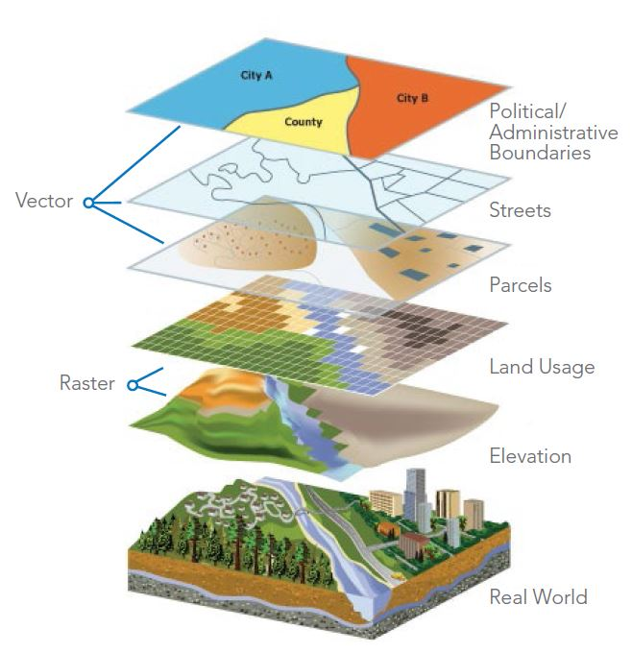
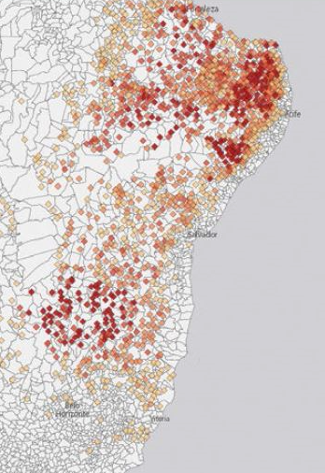
What is GIS?
A Geographic Information Science
Using spatial data and analysis to create new information
Also, what academics wish GIS stood for.
Better
Decisions
http://data-informed.com/how-spatial-analysis-leads-to-insight/

Slide 10
Why are we here?
Help get better careers
Improve the world for all living things

Slide 11
Student Success (2017)
Learning: 10 (knowledge, skills, accomplish tasks, projects, teamwork, communication, networking, perspectives, time management, getting help, tools)
Career prep: 9
Healthy: 3
Monies worth: 2
Graduating: 1
Grades: 1

Slide 12
Student Success
“Acquiring the skills, academic, professional, and interpersonal, that, when coupled with exposure to diverse perspectives and viewpoints encountered here, embolden students with agency and integrity to live in the world and make it a better place”
Robert Cowdrey
What helps:
Study habits, internships, research experience
Faculty engagement: help seek help, understanding, respect

Slide 13
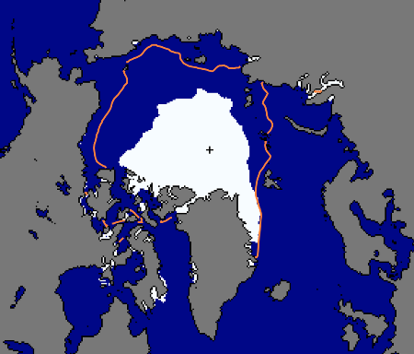
To Help Make Better Decisions
Sept. 24, 2012
National Snow and Ice Data Center, 2012

Slide 14
Antarctic Ozone Hole
Largest Antarctic Ozone Hole
September 2006

Slide 15
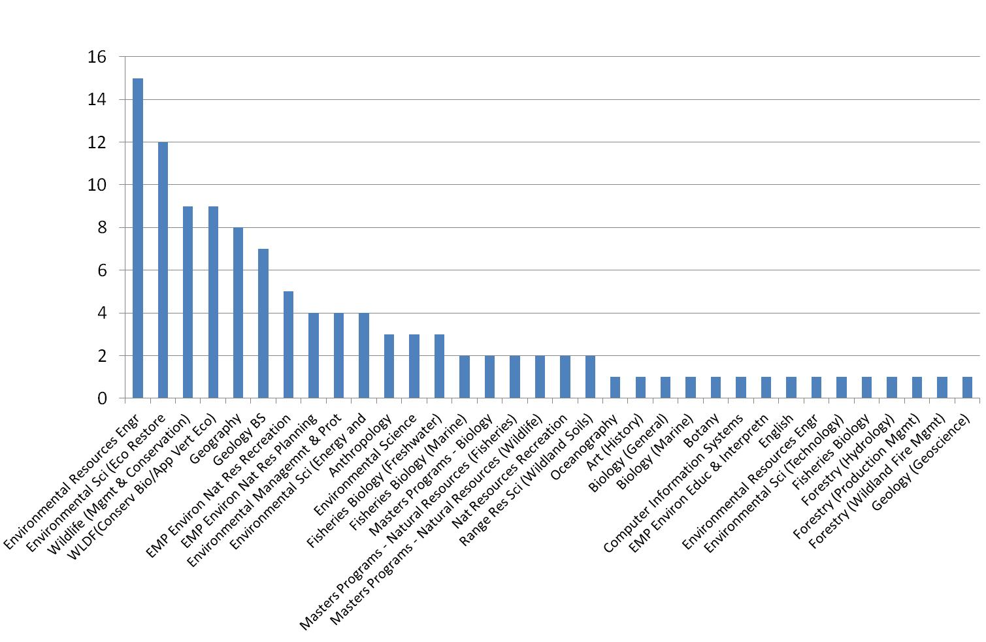
Who's using GIS?
“Bolstad: From Archeology to Zoology”

Slide 16
GIS is about:
Providing information and answering questions
With:
Reports
Maps
Posters
Web sites
From:
Spatial and a-spatial data

Slide 17
What do you need from me?
In groups of two:
What are the top three things that either help you to learn or prevent you from learning?

Slide 18
2017
Visual resources
In-class demos (no death by ppt)
Non-critical learning environ.
Hands on
Clear expectations
Research examples
Repetition of key concepts
Interpret data
Feedback
Practical apps
Personal experiences
Organize data
Map mobile sediments, social science
GIS Software
Make maps
Assesible
Useful supplemental materials
GIS resources

Slide 19
The Class Materials
Class web site: All the content
gsp.humboldt.edu -> Online Learning -> GSP 510
Canvas:
Assignments
Grades
Additional material will be presented in lab and lecture – attendance is critical!
I cannot cover all the material in class. You’ll need to read ahead, ask questions, and review the material again.

Slide 20
Class Organization
The schedule is organized by “Online Learning Modules” divided into weeks
Each week:
Review the web site over the weekend and do the indicated readings and activities
Meet twice a week for presentations / discussions
Start your lab on Tuesday and get it done by Friday!
Turn it in the following Tuesday and so on
Quizzes “periodically” instead of tests
During the final time, you’ll be presenting projects

Slide 21
To be successful
Turn in lab assignments on time!
Attend class, do the readings, etc.
Ask questions on confusing topics
Make good decisions
Follow the 20 minute rule:
If you’re stuck more than 20 minutes, get help
What is your learning style?
www.vark-learn.com/english/page.asp?p=questionnaire

Slide 22
Working Together
Technology is moving really fast
However, society is not keeping up
We need “norms” so we can work together constructively
Respecting everyone is key
To communicate effectively, you have to communicate from the other persons perspective
Remember, you’re sitting in a room of potential collaborators

Slide 23
Professionalism
Turn off phones (and other electronics things you are carrying) or set to vibrate
Make it to class on time,
If you need to, set your alarm 20 minutes early!
If you’re late, please come in quietly
If you need to leave during class
Let me know ahead of time and sit by the door
If you have a question, ask
Others may be wondering about the same topic

Slide 24
Communication
I communicate primarily through email and in person
Email:
“Yo, what assignment. Sent from my iPhone”
It’s easy to miss-read emails and hard to ask them clarifying questions

Slide 25
Emails
Proper subject line
Provide context so the reader understands the message
Provide a formal signature
For important emails, I write them and then re-read them later
For emotionally-charged emails, I write them, re-write them, have someone review them, and then don’t send some of them.
Instead, I’ll go out to lunch with the person

Slide 26
Bottom Line
The more time you spend working with a GIS, the better you will do
If you work hard and do the assignments on time
Me (and others) will be there to help you when needed
You just need to ask!
Be ready to help others as well

Slide 27
A few other things…
There will be a lab assigned this week and due next week!
Don’t forget to do the readings for this week

